Slide 1

MCTS Guide to Microsoft Windows 7
Chapter 9
User Productivity Tools

Slide 2
Objectives
Understand and configure Windows 7 printing
Understand Windows Fax and Scan
Use Windows Explorer libraries
Find files by using Search
Describe the features in Internet Explorer

Slide 3
Printing
The entire printing subsystem for Windows 7 has been redesigned
Redesign includes:
  XML Paper Specification
  The printing process
  Print drivers
  Printer management

Slide 4
Printing Scenarios
Local printing
  Requires that a printer be connected directly to a Windows 7 computer
  Simplicity and security
Printing to a shared printer
  When a printer is shared, multiple computers on the network can use it
  Sharing a printer saves money in the long run
  All print jobs are queued on the computer that is sharing the printer

Slide 5
Printing Scenarios (cont'd.)
Printing directly to a network printer
  Many printers can be configured to communicate directly with the network
    Using a print server
  Print jobs are queued at the local computer and sent to the printer when the printer is not busy

Slide 6
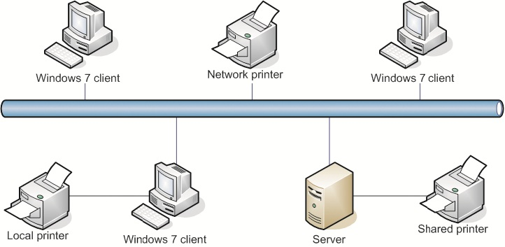
Printing Scenarios (cont'd.)

Slide 7
XPS
XML Paper Specification (XPS)
  Document format that describes how to display a page
  XPS document has same page layout on any printer
XPS is used as a document format for sharing files and as the format for spooled print jobs
Windows Presentation Foundation (WPF)
  Responsible for drawing the screen output in Windows 7
XPS uses a subset of WPF to render documents

Slide 8
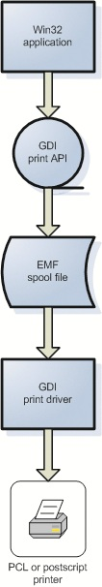
The Printing Process
GDI-based printing
  Used by previous versions of Windows
  A Win32 application uses GDI to create an enhanced metafile format (EMF) file for the print job
  EMF file is stored in the printer queue
    Must be converted to the format understood by printer
  Printers typically understand either Postscript or Printer Control Language (PCL)

Slide 9
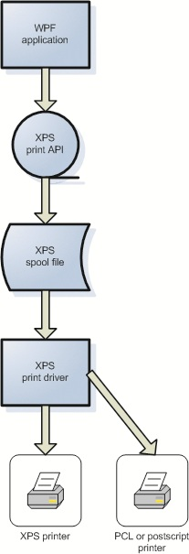
The Printing Process (cont'd.)
XPS-based printing
  Used by Windows 7 and 8 applications
  WPF application creates an XPS file for the print job
  Some printers support XPS format
    Printing job does not need to be converted
  For printers that only support PS or PCL
    Printing job needs to be converted
Backward compatibility
  Windows 7 and 8 printing process is flexible to accommodate older applications and older printers that do not support XPS-based printing

Slide 10
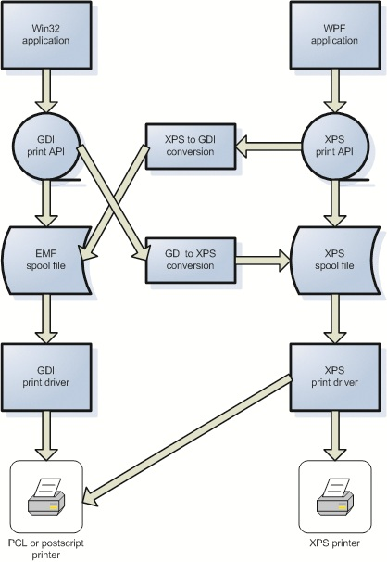
The Printing Process (cont'd.)
Backward compatibility
  Windows 7 and 8 printing process is flexible to accommodate older applications and older printers that do not support XPS-based printing

Slide 11
The Printing Process (cont'd.)
Benefits of XPS-based printing
  XPS printing is better at handling complex graphics than GDI-based printing
  Improved color printing
  Improved print quality
  Improved print job configuration
  Improved device configuration
  Improved spooling

Slide 12
Printer Drivers
Adding drivers to the store
  Known as staging a driver
  Printer driver is added during installation process
  When drivers are added to the store, they are stored side-by-side
    Multiple versions of the same driver can be in the store
Printer driver installation process
  For previous versions of Windows
    Printer drivers were distributed as printer driver packages and just printer drivers

Slide 13
Printer Drivers (cont'd.)
Printer driver installation process (cont'd.)
  When printers were networked
    Point and print allowed printer drivers to be distributed automatically from the print server
      But not driver packages
  With Windows 7
    Driver packages can be distributed by point and print
  Printer driver installation process variations
    Local printer
    Remote printer
    Network printer
    Web printer

Slide 14
Printer Management
Devices and Printer applet
  Manages the printers on a local workstation
  Can’t install printers on remote computers
  Major tasks in the Printers applet
    Add a printer
    See what’s printing
    Set as default
    Select printing preferences
    Configure printer properties
    Configure printer server properties
    Remove device

Slide 15
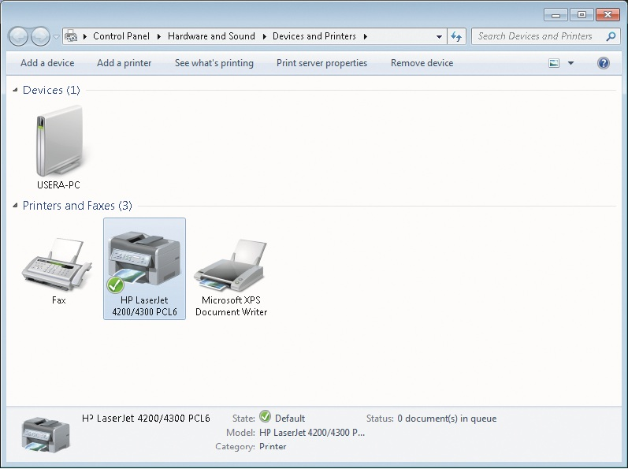
Printer Management (cont'd.)

Slide 16
Printer Management (cont'd.)
Print Management snap-in
  Allows you to manage the printers for your entire network from a single workstation
  Features of the Print Management snap-in
    Manage multiple print servers
    Filter views
    Automatic installation of printers on a print server
    Bulk printer management
    Use Group Policy to deploy printers
    Notification

Slide 17
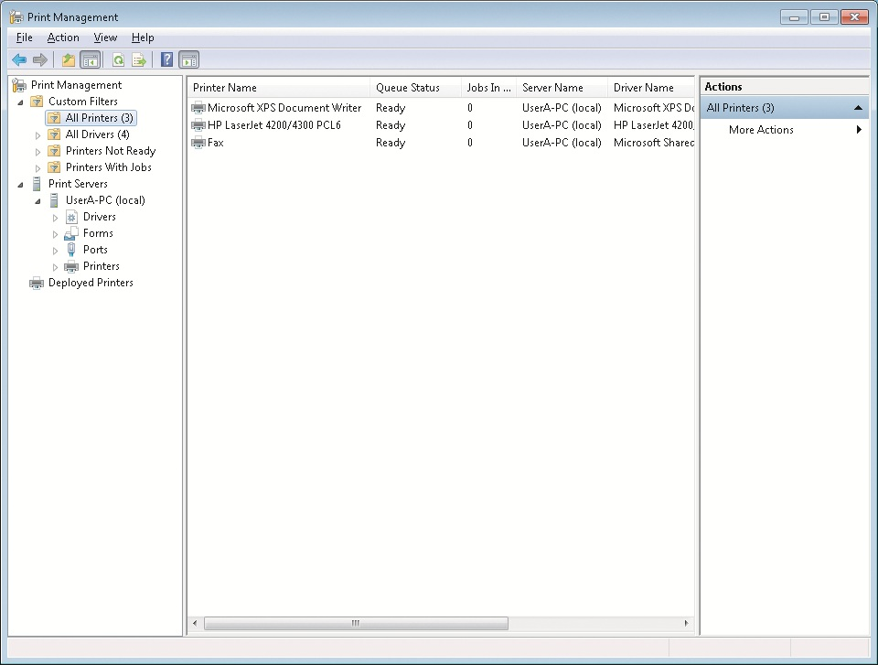
Printer Management Window

Slide 18
Printer Management (cont'd.)
Printer configuration options
  Each printer you install in Windows 7 can be configured independently
  Most of the options available for configuration are standardized by Windows 7
  Device Settings tab has device-specific settings
  Advanced tab has a number of options that are typically only implemented for server-based printing
  Other standard tabs
    General
    Sharing
    Security
    Ports
    Color Management

Slide 19
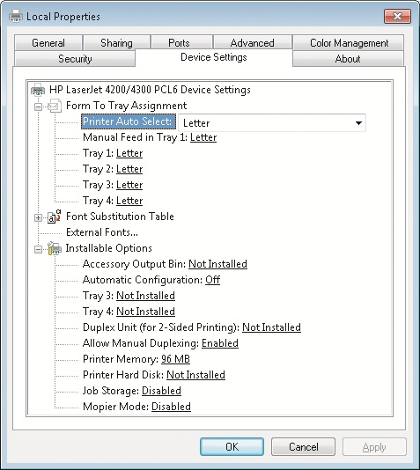
Local Printer Management Dialog Box

Slide 20
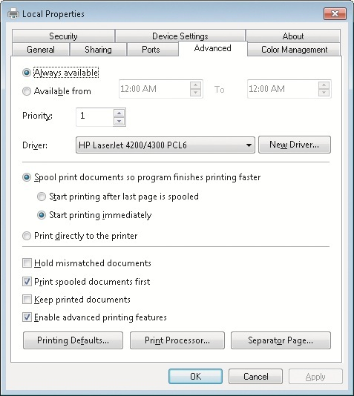
Local Printer Management Dialog Box

Slide 21
Printer Management (cont'd.)
Printer sharing and security
  Sharing is enabled and controlled on the Sharing tab
  Sharing tab allows you to:
    Enable sharing for the printer
    Define the share name for the printer
    Specify whether print jobs are rendered on the client computer or print server
    Add drivers for other operating systems to download by using point and print

Slide 22
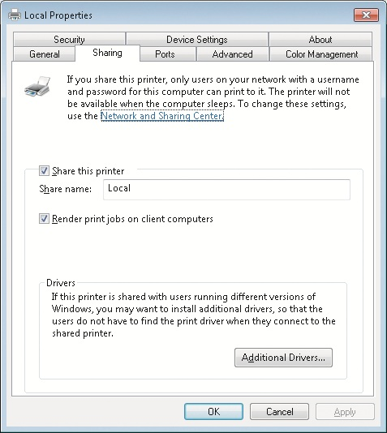
Local Printer Management Dialog Box

Slide 23
Printer Management (cont'd.)
Printer sharing and security (cont'd.)
  Default permissions for printing
    Everyone
    CREATOR OWNER
    Local Administrator User (Userx)
    Administrators

Slide 24
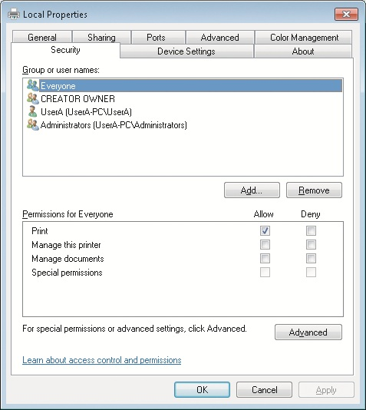
Local Printer Management Dialog Box

Slide 25
Printer Management (cont'd.)
Print job management
  For each print job, you can:
    Pause
    Resume
    Restart
    Cancel
    Edit job properties
  Situations where you might want to manage jobs:
    Restarting a print job when there has been a paper jam
    Pausing a large print job
    Raising the priority of a print job
    Changing the schedule of a large print job
    Canceling a corrupted print job

Slide 26
Windows Fax and Scan
New utility in Windows 7 that is used to control scanning and faxing documents in Windows 7
Windows Fax and Scan is optimized to scan documents for faxing
By using Windows Fax and Scan, you can:
  Scan documents and pictures
  Fax scanned documents and pictures
  Fax electronic documents
  Receive faxes
  Create and manage fax coversheets

Slide 27
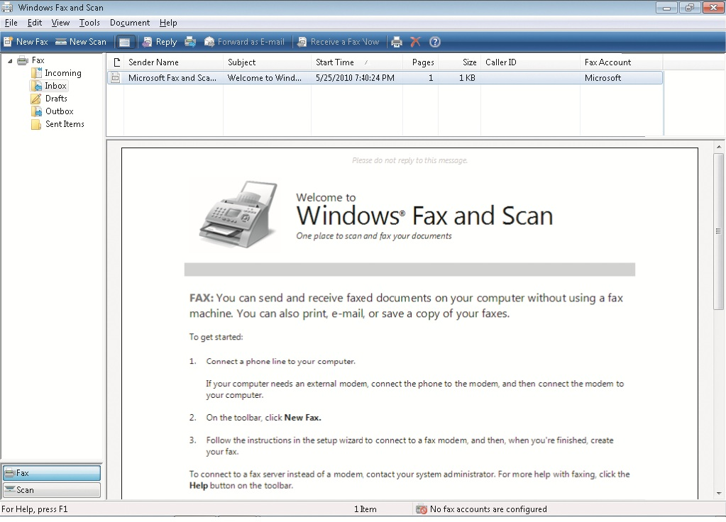
Windows Fax and Scan Window

Slide 28
Windows Fax and Scan (cont'd.)
By using Windows Fax and Scan, you can (cont'd.):
  Forward received faxes, scanned documents, and scanned pictures by using e-mail
  Send faxes by using a central fax server
  Maintain a contacts list that includes phone numbers for faxing
Requires you to have:
  A fax modem and scanner or
  A multifunction device that performs both functions

Slide 29
Windows Explorer
Windows Explorer
  Interface for viewing the file system in Windows 7

Slide 30
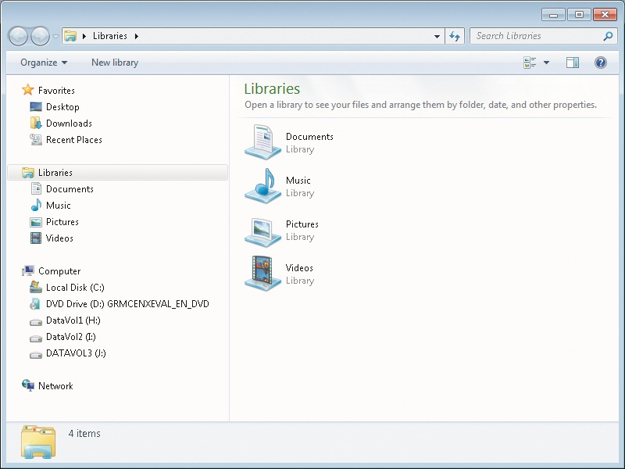
Windows Explorer Window

Slide 31
Libraries
New feature in Windows 7 that simplifies access to data
Each library displays the files from multiple locations
You can modify the locations that are included in a library

Slide 32
Views
Previous versions of Windows allow you to alter the Windows Explorer view
Windows 7 still has these options and several variations
Windows 7 has also introduced Arrange by options to help you organize information

Slide 33
Window Management
You can use snap to:
  Automatically size windows the full height of the screen
  Arrange windows side by side
  Maximize a window
Other AERO specific enhancements
  Live taskbar thumbnails
  Live icons
  Windows Flip
  Windows Flip 3D

Slide 34
Search
Search has been integrated into almost every window in the Windows 7 user interface
Search is made faster by an indexing function included in Windows 7
You can define metadata for files
  And use it to build saved searches that are displayed as virtual folders

Slide 35
The Search Index
Indexing service
  A major improvement over the indexing service included with Windows XP
  Automatically enabled
  Index is updated each time a file is changed
By default, only the most common file locations are indexed
  Internet Explorer History
  Offline files
  The Start menu
  Users (except the AppData subfolder)

Slide 36
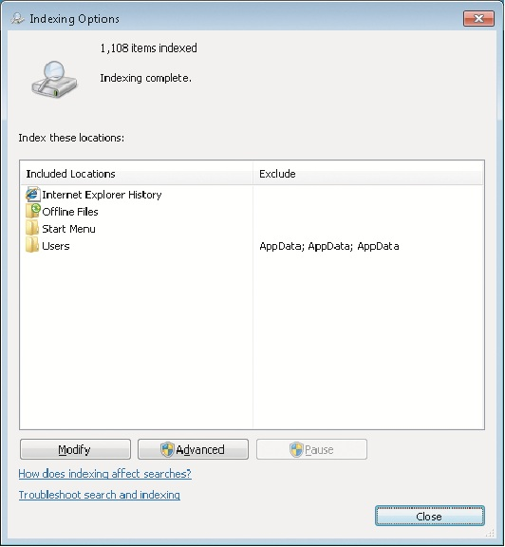
Indexing Options Dialog Box

Slide 37
The Search Index (cont'd.)
You can define which file types are indexed and how those files are indexed
Word documents can have their content indexed so that you can search for documents based on content
Additional index settings
  File Settings
  Troubleshooting
  Index location

Slide 38
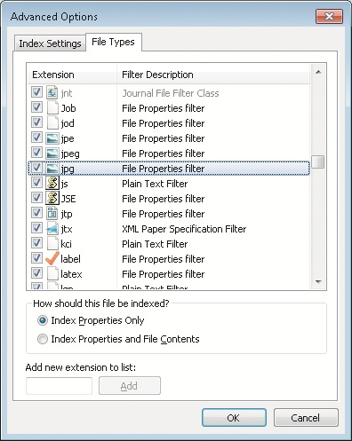
The Search Index (cont'd.)

Slide 39
File Metadata
Most basic file metadata
  Filename, creation date, and modified date
Depending on the type of file, additional metadata may be included
Metadata is included in the index
  Useful to create additional metadata for files
Windows 7 allows you to create tags that contain additional metadata for organizing your data

Slide 40
Saved Searches
Saved search
  Virtual folder containing files matching a search query
    Regardless of their location in the file system
Stored in the Searches folder of your user profile
  Also added to the favorites list in Windows Explorer

Slide 41
Internet Explorer User Features
Tabbed browsing
  Allows Internet Explorer to control multiple Web sites being open at the same time
Can use Really Simple Syndication (RSS) feeds to display information from Web sites that you have selected
Web Slices are small pieces of content from a Web site that notify you there is an update

Slide 42
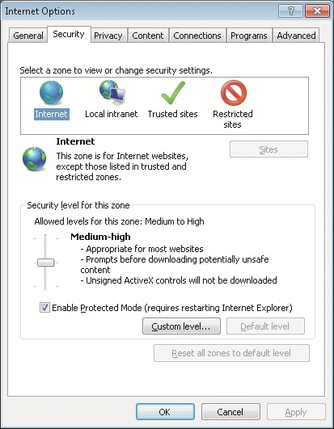
Security
Zones for Internet Explorer security options:
  Internet
  Local intranet
  Trusted sites
  Restricted sites
Internet Explorer Protected Mode
  Works in conjunction with UAC to prevent malicious software from installing through Internet Explorer
  Prevents the silent installation of malicious software from Internet sites

Slide 43
Security (cont'd.)
Intranet Zone Configuration
  In a domain-based network, Internet Explorer assumes that all Web sites in the local domain are part of the Intranet zone
Smartscreen Filter
  Warns you when you are about to access a Web site that is known to install malicious software or is used as part of a phishing attack

Slide 44
Privacy
InPrivate Browsing
  Allows you to access the Internet without any information being stored in cache or history
InPrivate Filtering
  Allows you to control whether information about you is sent to advertisers that embed their content in other Web sites

Slide 45
Tools
Popup Blocker
  Prevents most popup advertisements from being displayed
Internet Explorer 8 includes strong adherence to Internet standards for Web page rendering
Compatibility View
  New feature that provides backward compatibility for Web sites and application
Internet Explorer is extensible with Add-ons

Slide 46
Summary
Windows 7 uses a new printing process that uses the XPS format for spool files
Windows 7 stores printer drivers in a driver store
Print Management snap-in is a new management tool to manage local and remote printers
Printers can be configured with many options
When print jobs are stored in the print queue, you can manage the jobs

Slide 47
Summary (cont'd.)
Windows Fax and Scan is used to fax and scan documents in Windows 7
Windows Explorer now includes libraries to simplify access to files
Search is integrated into many parts of Windows 7
Internet Explorer 8 includes Web Slices and Suggested Sites
Internet Explorer divides Web sites into zones
To enhance privacy, Internet Explorer 8 includes InPrivate Browsing and InPrivate Filtering
Compatibility View provides backward compatibility with previous versions of Internet Explorer

